Slide 1

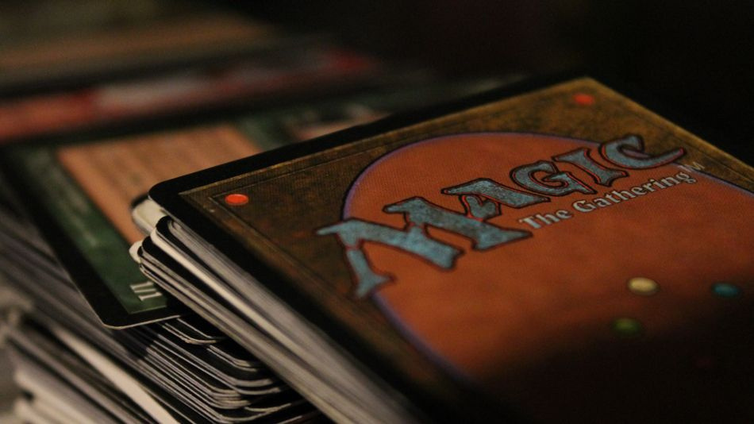
Project 1 - Group 1
Magic: The Gathering - Tournament Pioneer Decks

Slide 2
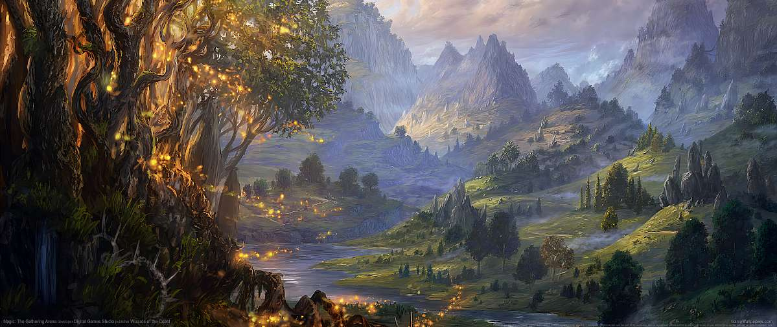
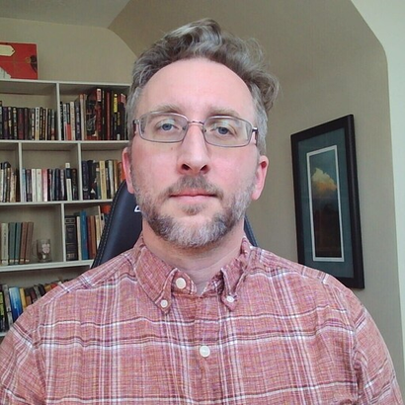




MEET OUR TEAM
Steven Madden
Seven George
Laura Zapata
Earl J Lewis
Judith Landa-Sanchez
Data set: https://www.kaggle.com/datasets/scarfsman/magic-the-gathering-winning-pioneer-decks
Thesis: We will utilize data to delve into tournament decks within the card game Magic: The Gathering. Our aim is to discern patterns within popular decks to identify potential strategies.

Slide 3
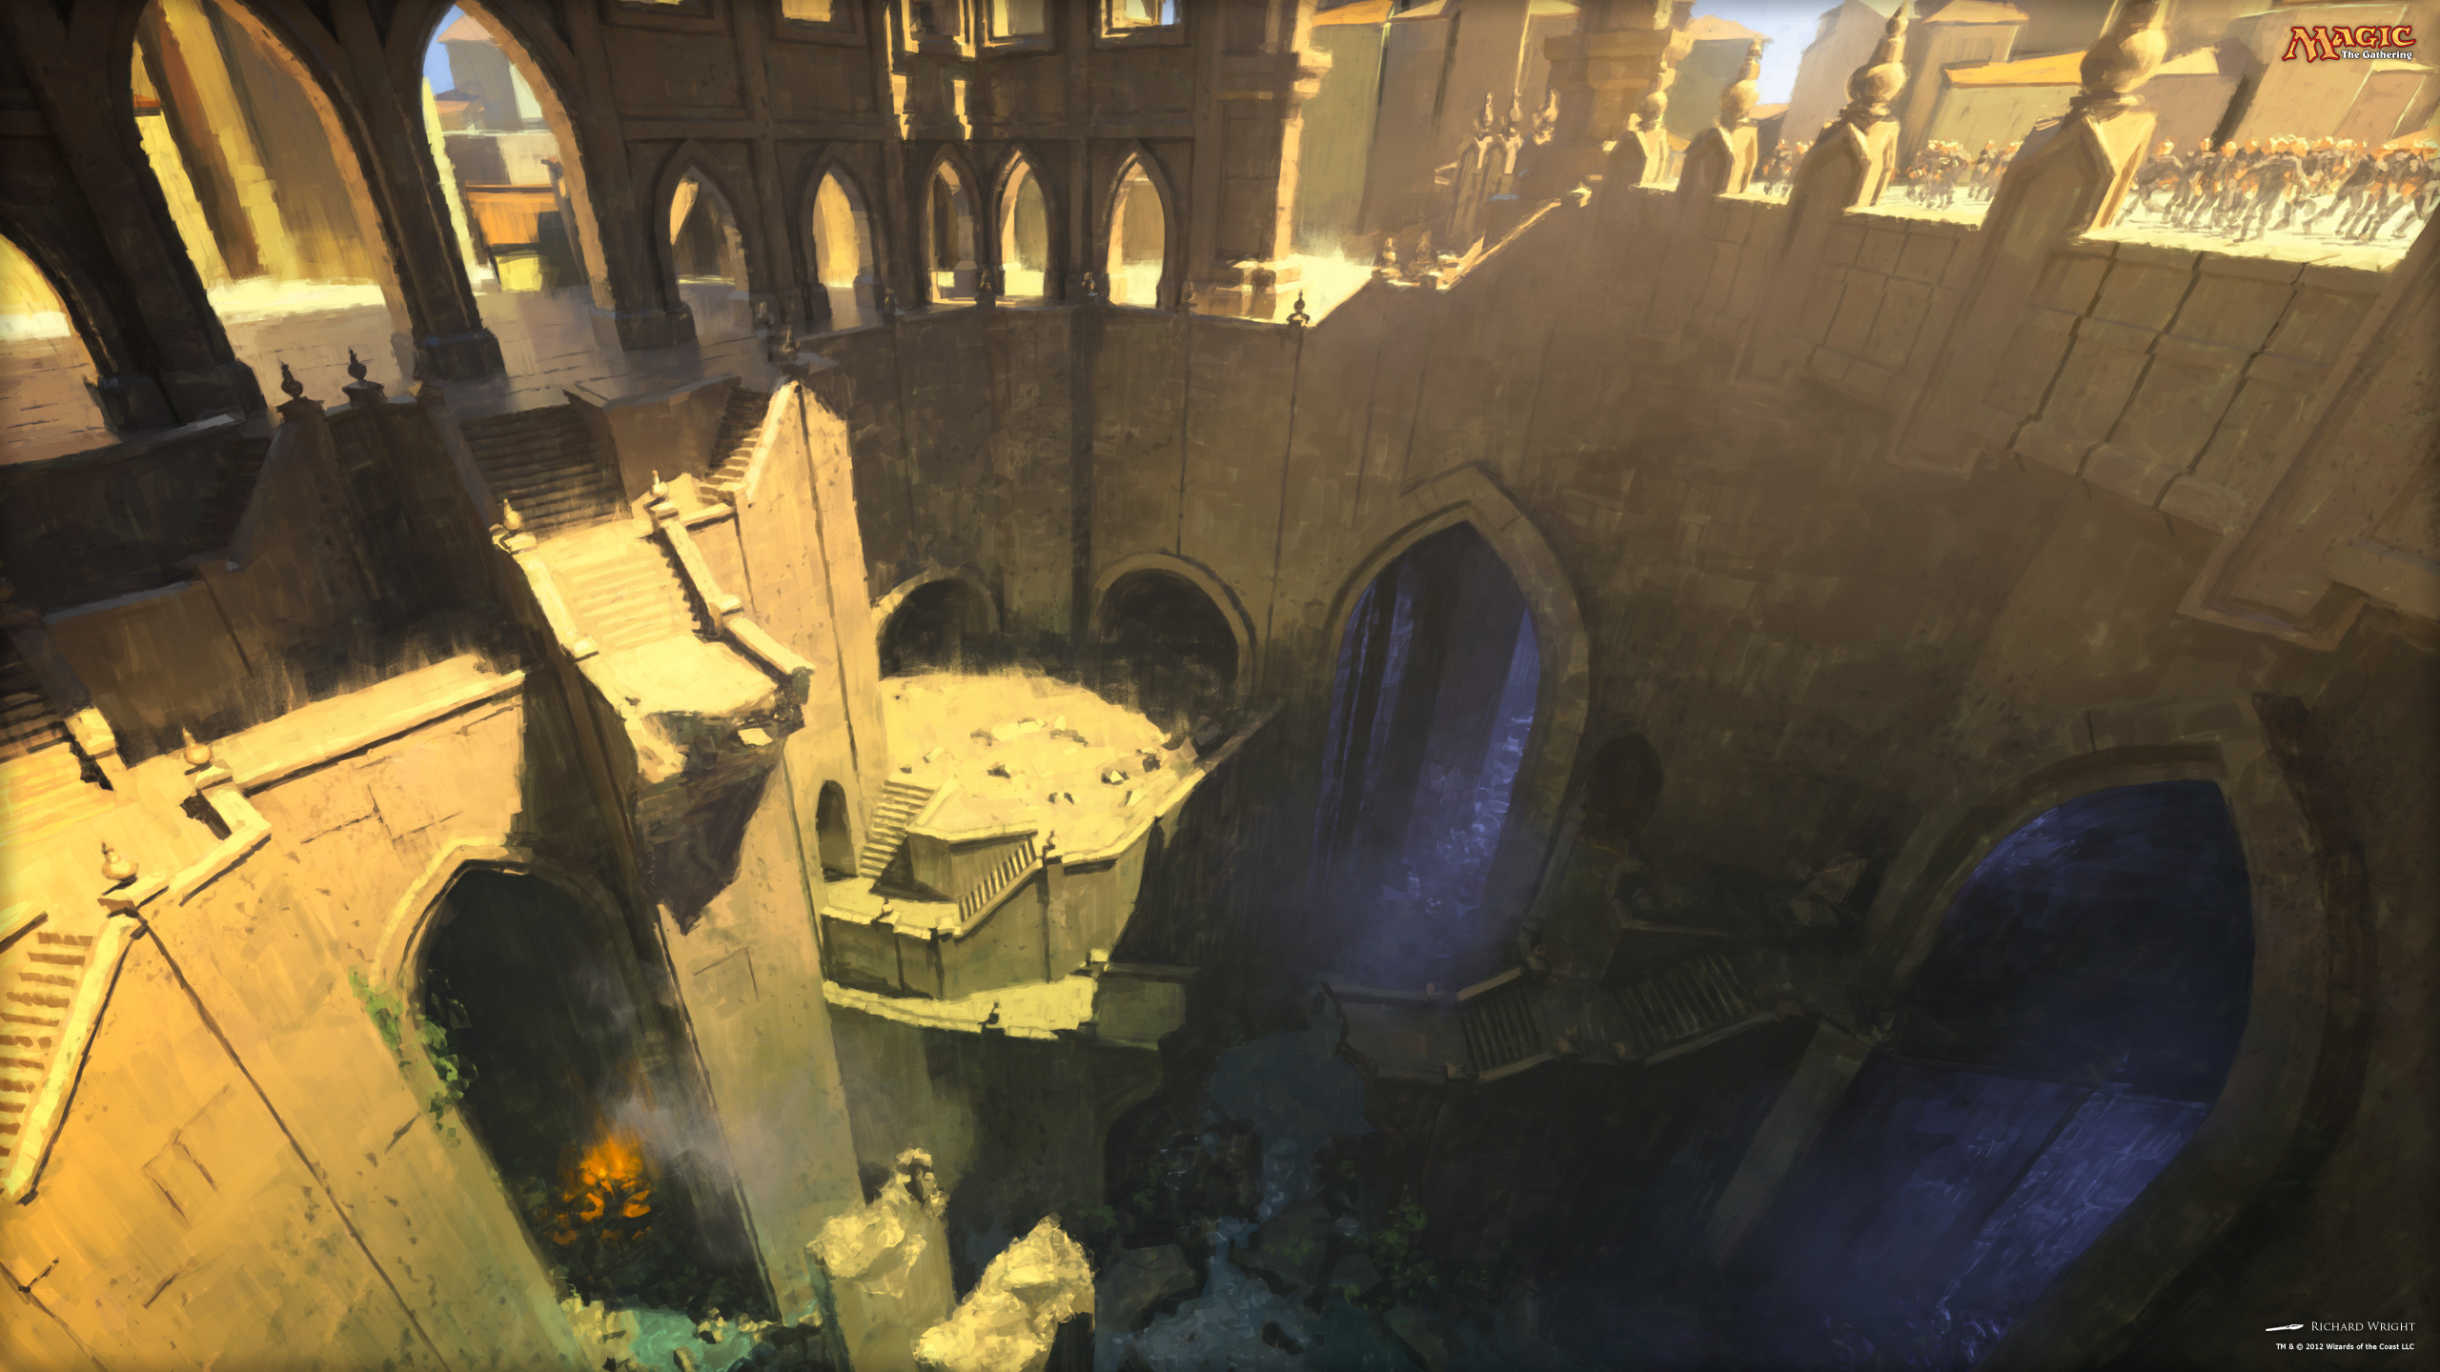
DATA CLEANING
First, we dropped the unnecessary Date Posted column and the redundant Euro value column. To address misleading null values, we marked all lands as ['L'] in both the Colours and Mana Cost columns.
01
We converted the printing date to DateTime by adding a timestamp and creating a Printing Dates column. We mainly used this DataFrame but created another by dropping null values from the Price USD column for our line regressions.
02

Slide 4
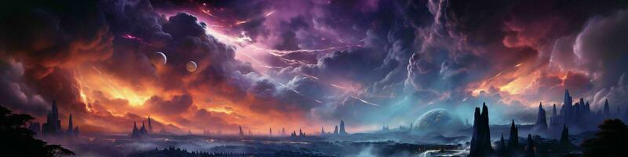
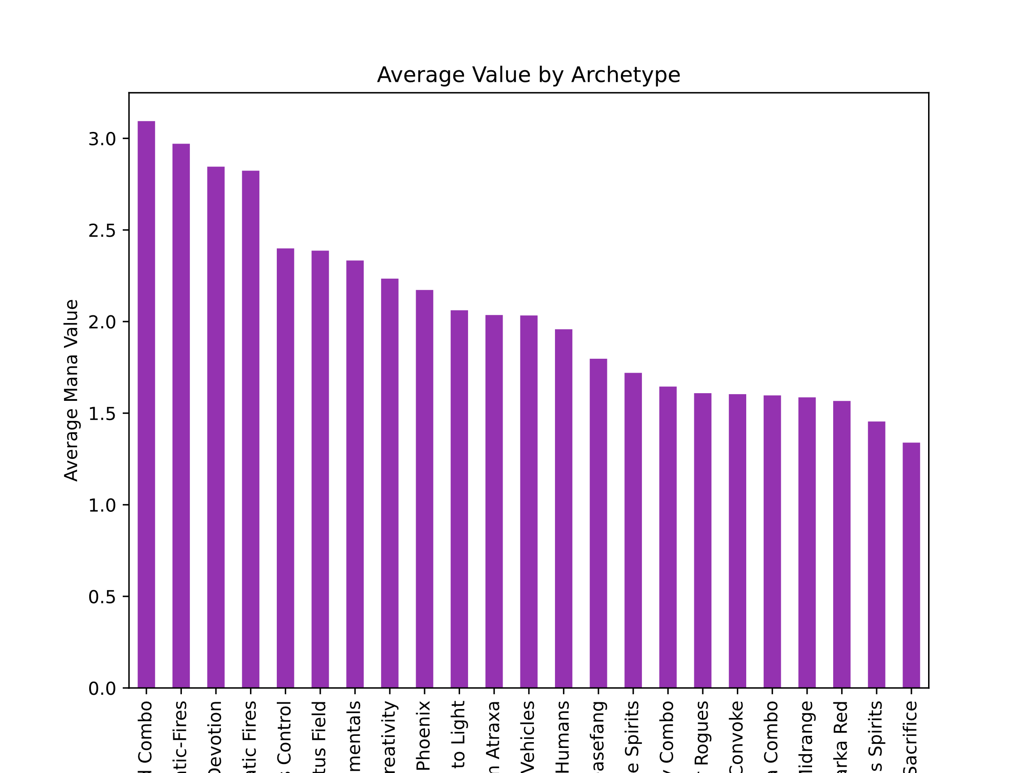
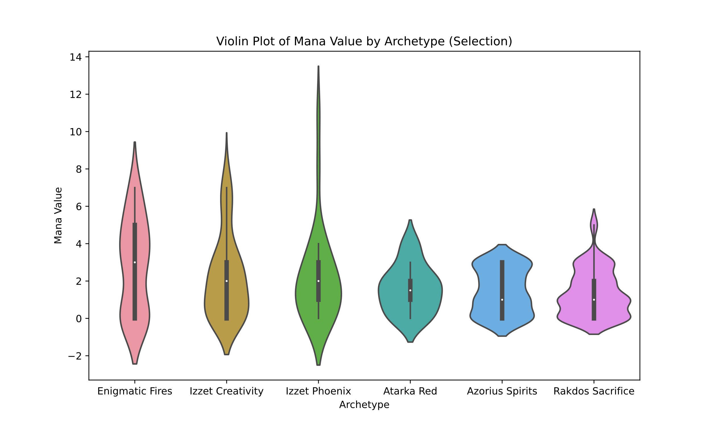
What is the average converted mana cost of decks, and is there a discernible threshold?
Looking at the average converted mana cost per card in these archetypes, we see the vast majority of them keep their average converted mana cost at two or slightly lower.
So if we are interested in build a competitive deck, we see we want to keep our converted mana cost around two per card.

Slide 5
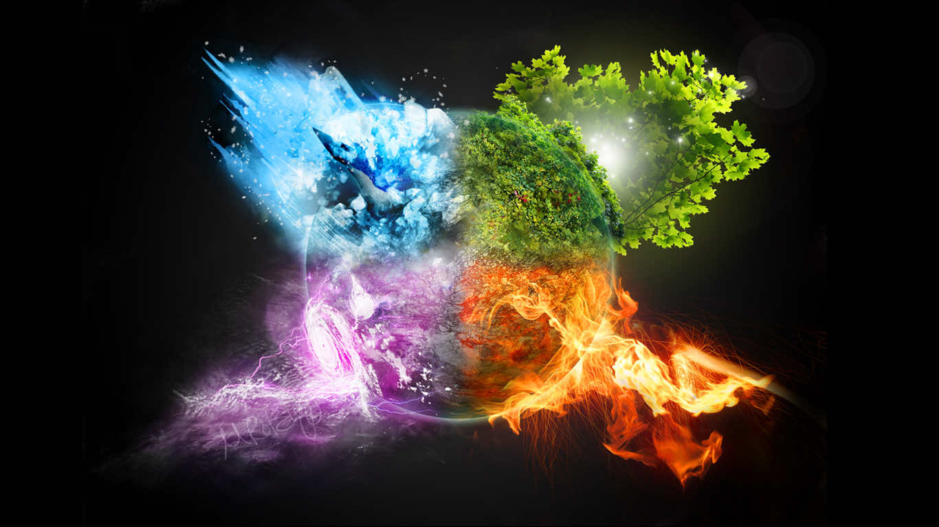
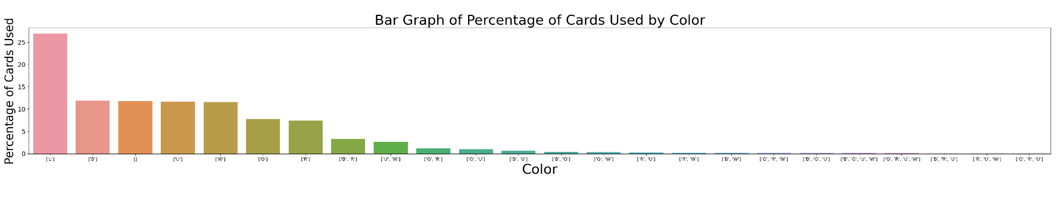
Which colors appear the least?
They all appear once:
We want to avoid using triple-color cards as much as possible
Black Red U-Blue:
Red UBlue White:
Green Red U-Blue
We found out cards that are tripled colored are harder to play due to the mana cost. We concluded the least played card colors are B, R, U, and R, U, W, and G, R, U. They are played at a percentage of under 1%.

Slide 6
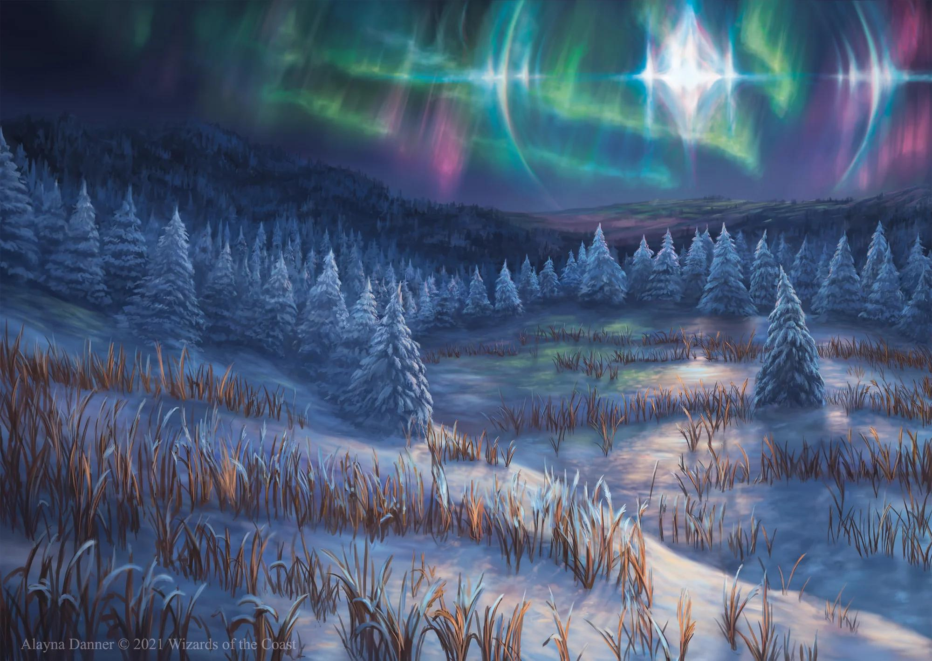
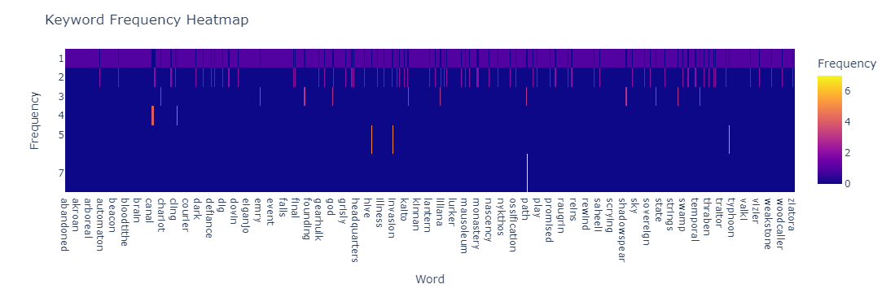
How frequently do specific keywords appear in winning decks?
In winning decks, certain words show up a lot.
These words usually represent important things like powerful abilities or common strategies.
For example, words like "attack," "defense," "special moves," or "big creatures" are common.
The number of times these words appear can vary depending on what strategies are popular at the time.
So, in a nutshell, winning decks often use certain keywords quite frequently to build their strategies effectively.

Slide 7
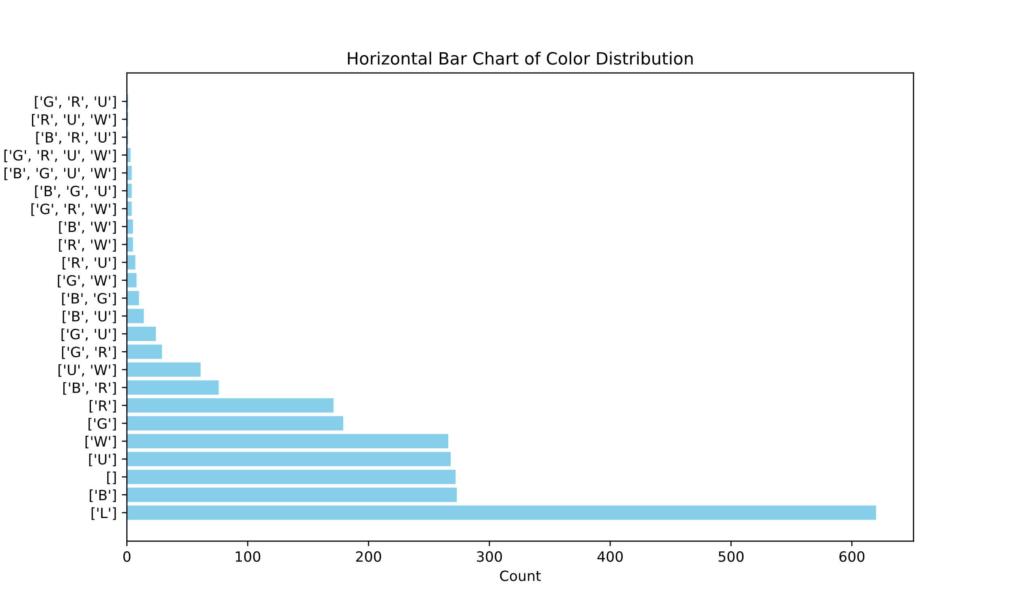
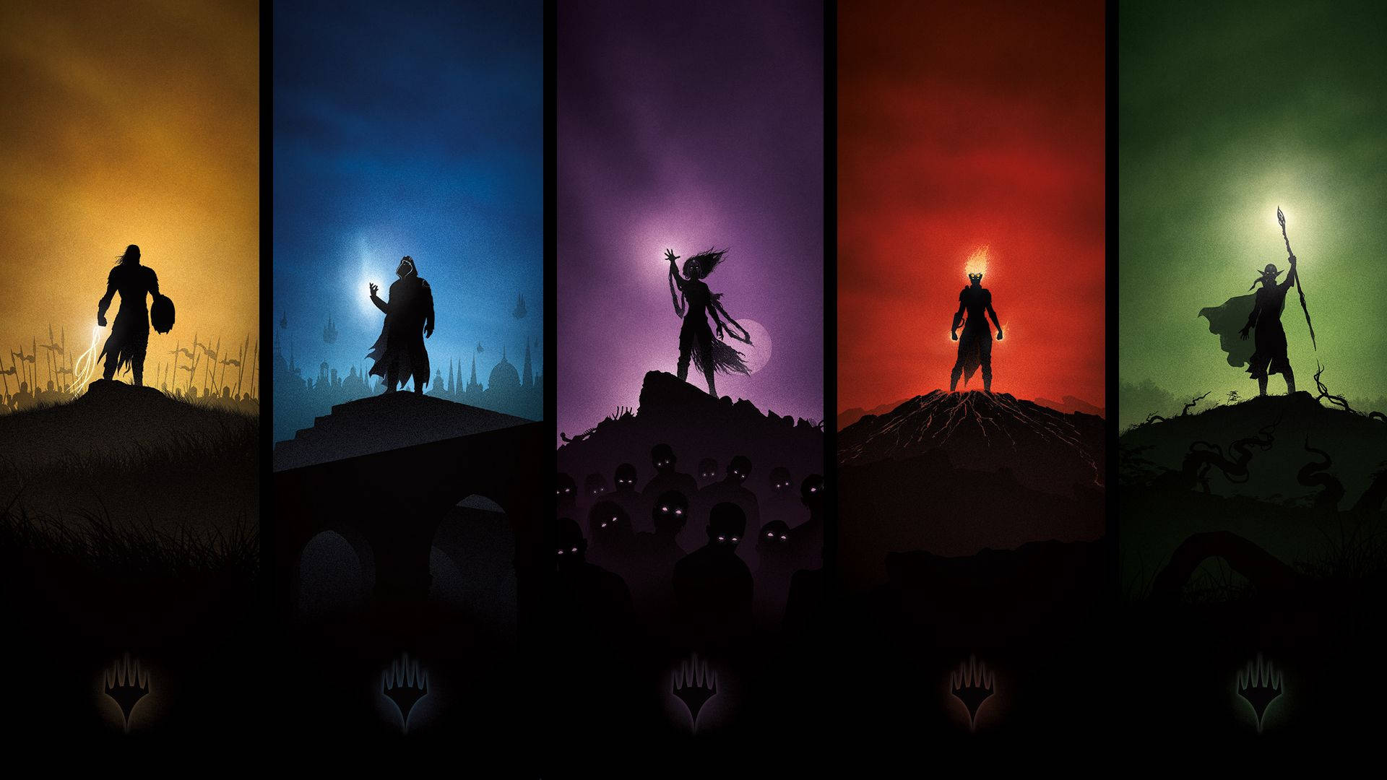
Which colors dominate tournament decks in terms of frequency?
Lands are the largest bar on the chart; these are not creatures or spells.
The most common colors (of creatures and spells) are black, colorless, and blue.
This suggests deck builders looking to build competitive decks should use archetypes related to these colors.

Slide 8
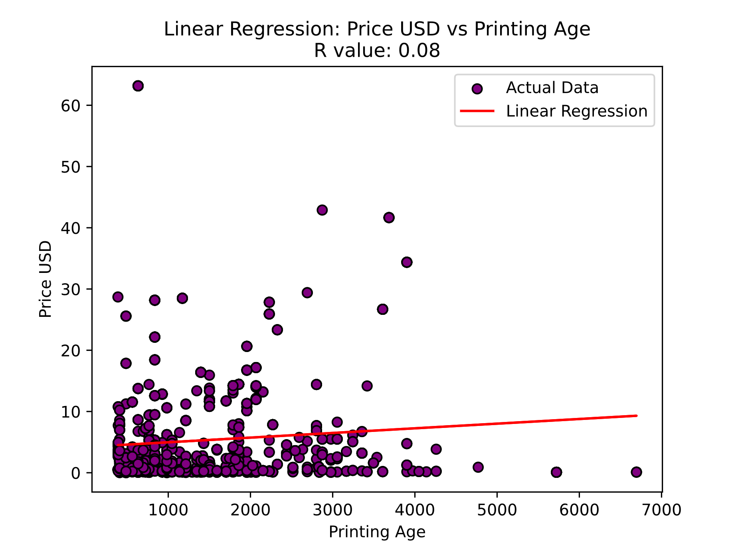
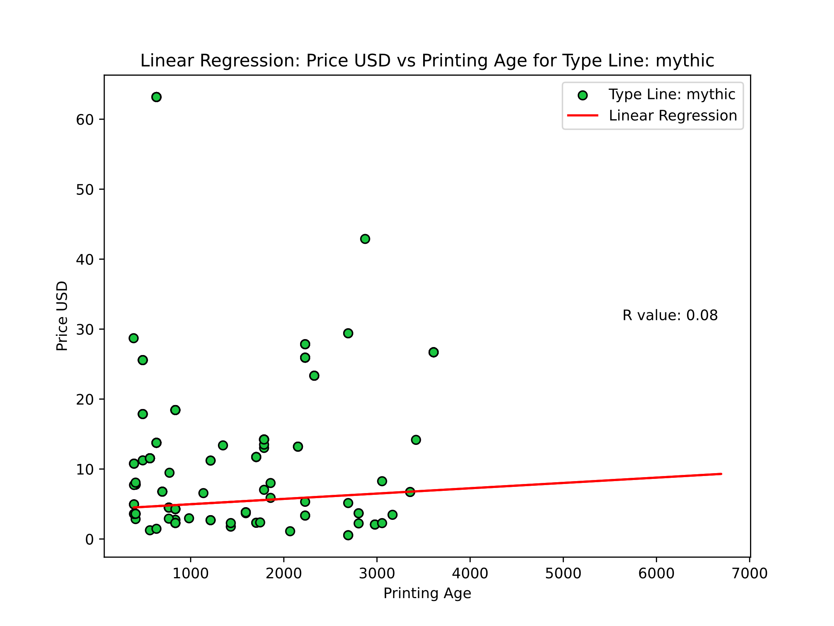
BORCELLE
LINEAR MODELLING
Contact
We wanted to see the relationship between the age of cards used and their value in USD to see if there was a relationship between the cost of the cards and how old they were. With an R value of 0.08,
We saw there was no relationship. To look further, we did several more regressions, looking at each classification of rarity: common, uncommon, rare, and mythic.
However, even when broken down by rarity, we see there is little to no relationship between the age of the cards and the value

Slide 9
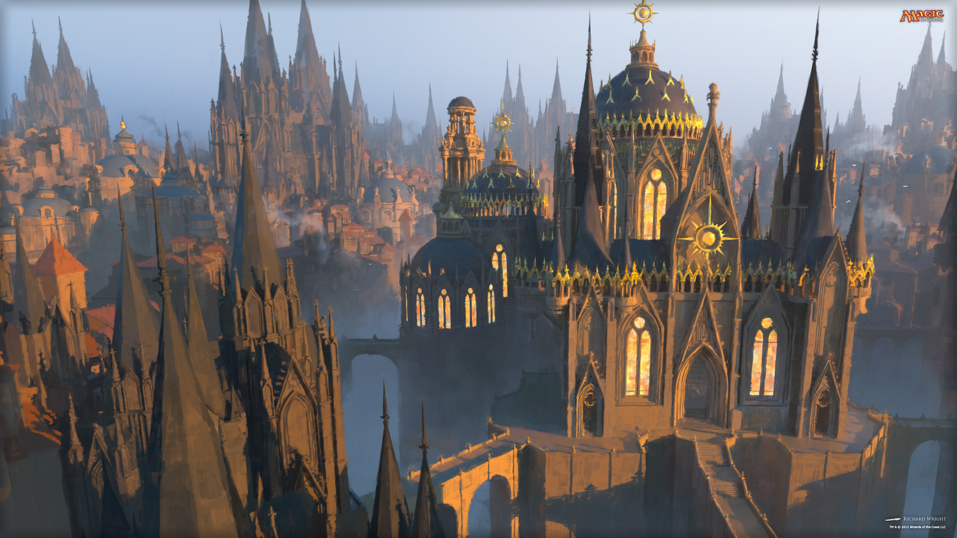
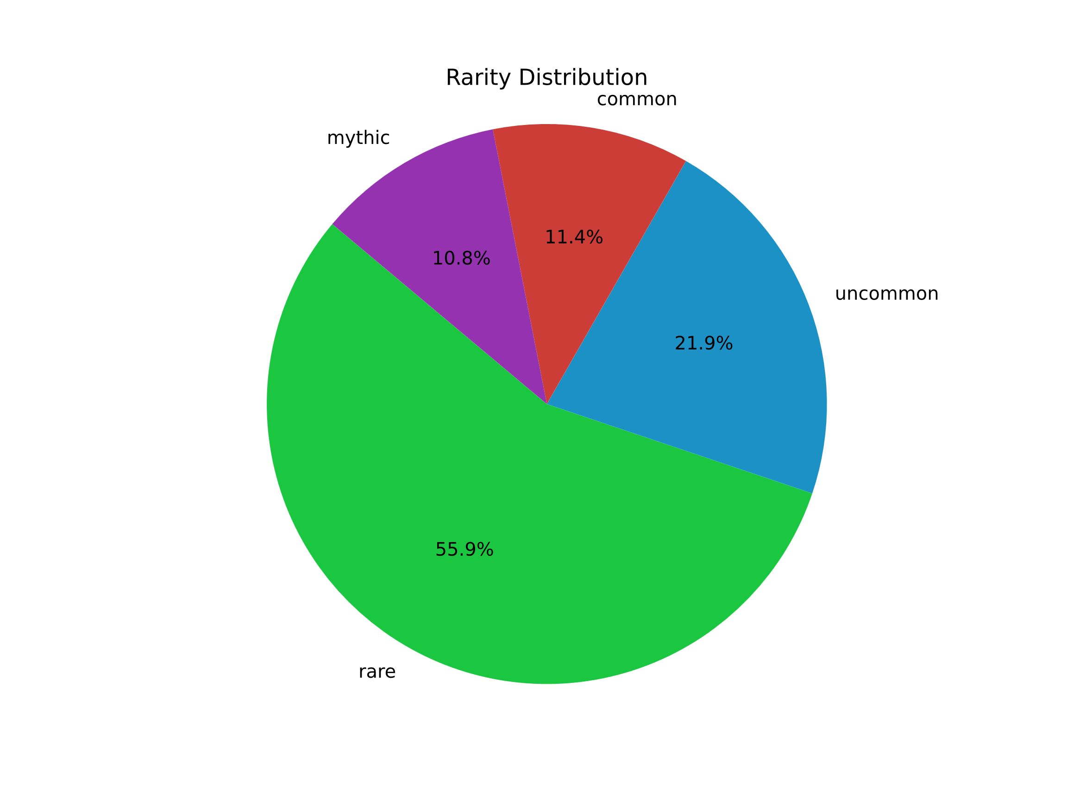
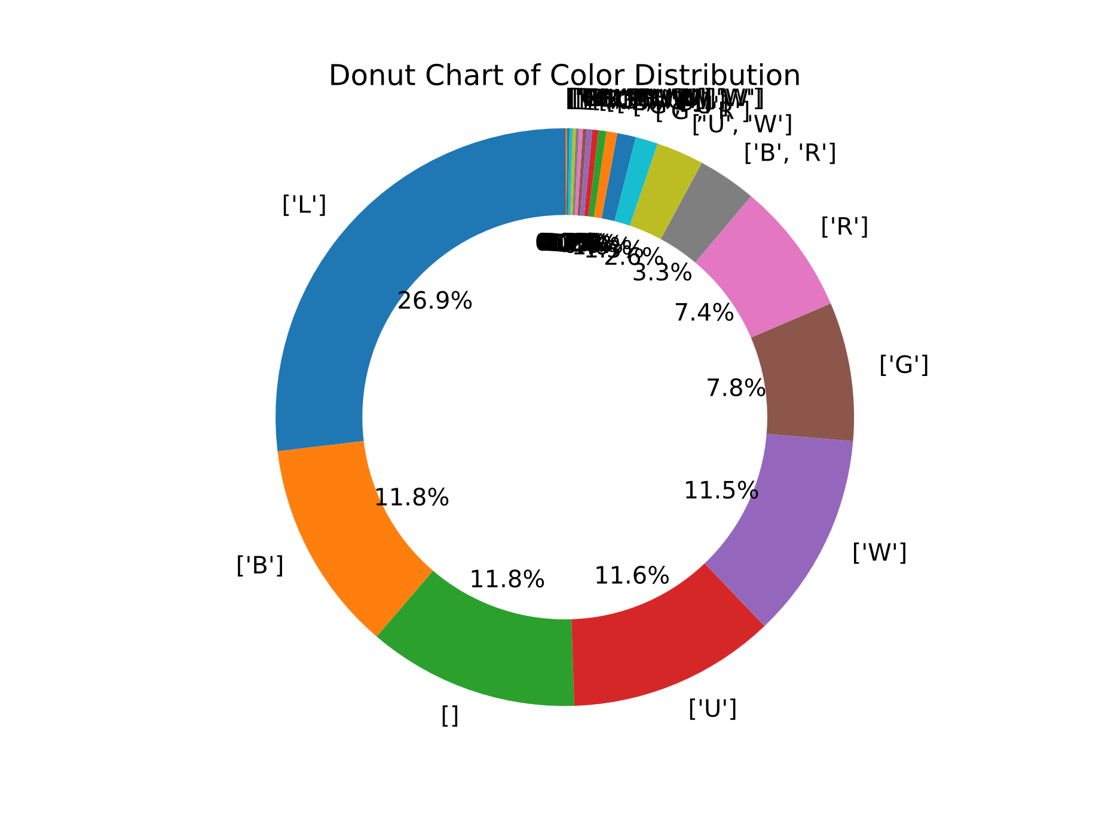
ADDITIONAL INFO:
Only 2 decks were used in all four tournaments and a pie chart braking down the use of common, uncommon, rare and mythic cards showing rare being the most used by more than half.

Slide 10
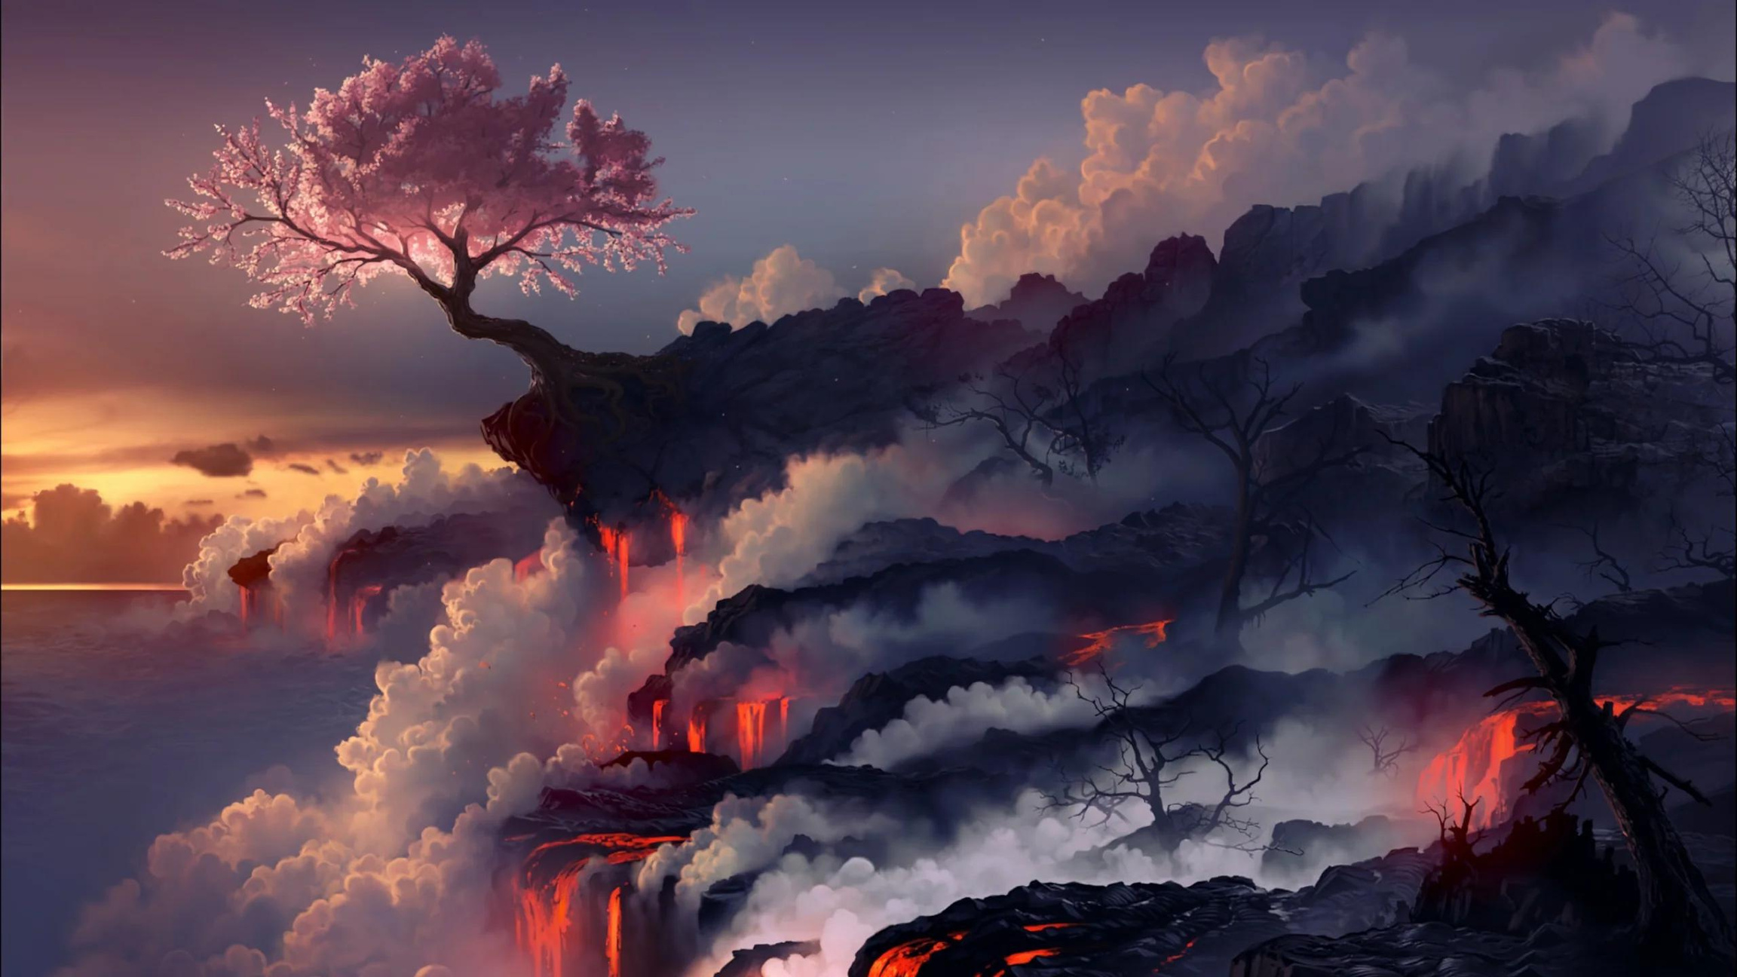
Call to Action
Card Rarity Distribution: Our research indicates that 65% of the cards in competitive decks are rare or mythic. This suggests that if you’re aiming to build a competitive deck from scratch, you should focus on acquiring rare and mythic cards rather than common or uncommon ones.
Mana Cost Strategy: Another important finding is that the average converted mana cost of cards in these competitive decks is around two, with only a few going up to three. Therefore, if you’re new to Magic and want to build a strong deck, you should aim for an average mana cost of around two and prioritize rare and mythic cards.
By following these insights, you can create a more competitive deck and enhance your chances of success in the game by looking to build out decks with blue, black, or colorless.

Slide 11
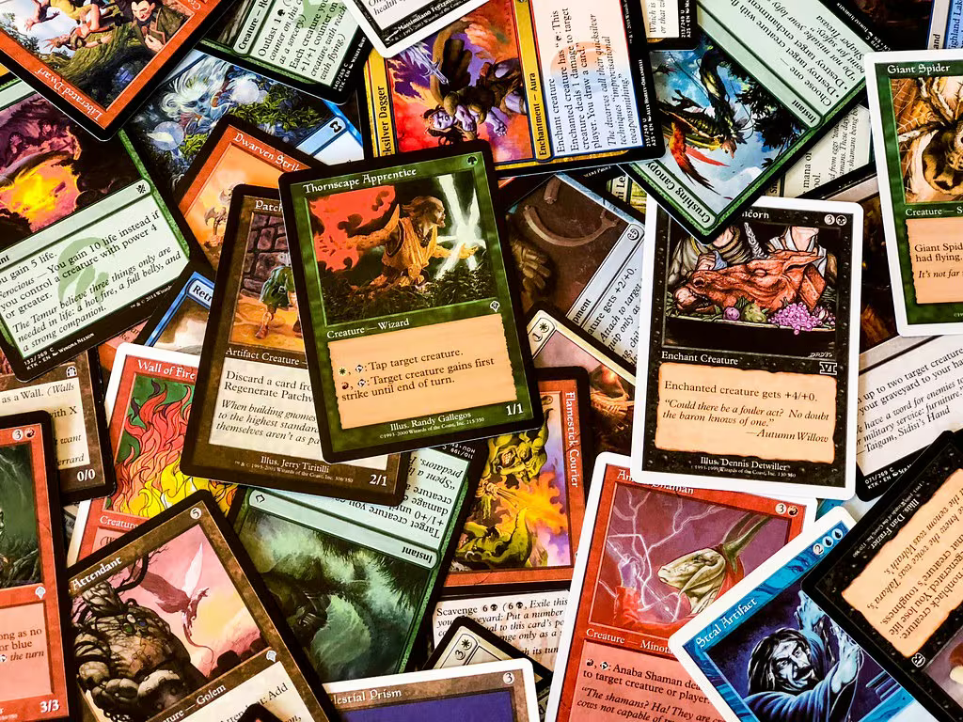
BORCELLE
Home
Photo
About Us
Contact
BIAS AND LIMITATIONS
Bias:
The team anticipated that blue would be the most used color and were surprised to find that it was not.
Limitations:
Is the absence of performance records for individual decks in the dataset. Without knowing how well each deck performed for the participants, we cannot develop a winning strategy based in the data.
This lack of specific performance information hinders our ability to identify the successful decks.
+123-456-7890
www.reallygreatsite.com
hello@reallygreatsite.com
123 Anywhere ST., Any City, ST 12345

Slide 12
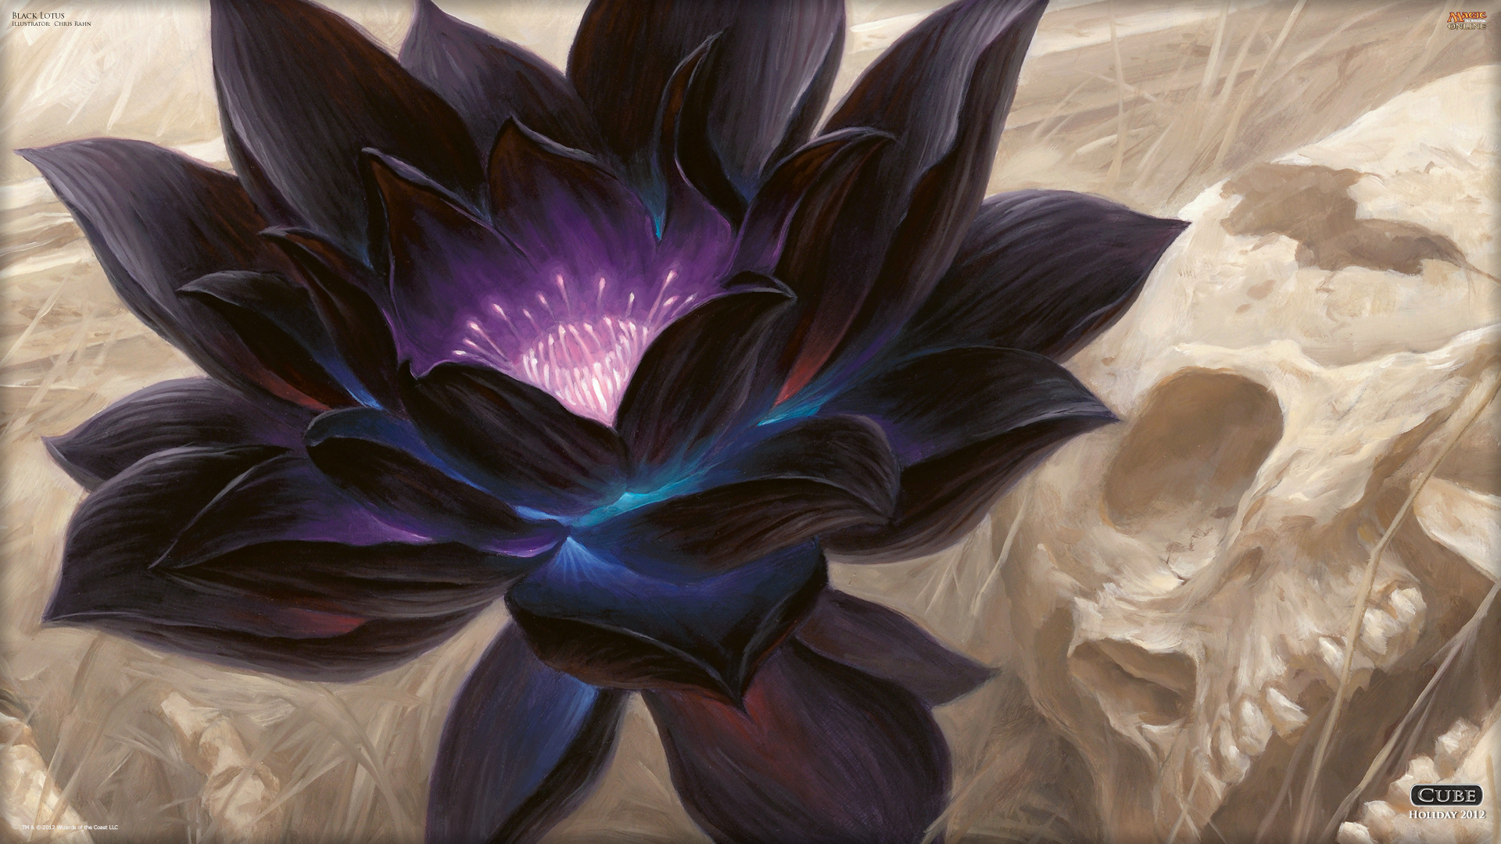
BORCELLE
Home
Photo
About Us
Contact
FUTURE WORK
Build several decks based on our findings to test their performance.
Focus on rare and mythic cards with an average converted mana cost of 2 or less, using black, colorless, and blue, avoiding triple color cards, and not assuming financial value equates to play utility.
Research tournament results to see which decks won and their win/loss records

Slide 13


BORCELLE
WORKS CITED
https://www.kaggle.com/datasets/scarfsman/magic-the-gathering-winning-pioneer-decks
https://www.atlassian.com/data/charts/heatmap-complete-guide
https://stackoverflow.com/questions/508727/python-time-to-age
Time Stamp from Professor Booth

Slide 14
Questions & Answers
Thank you

